Slide 1
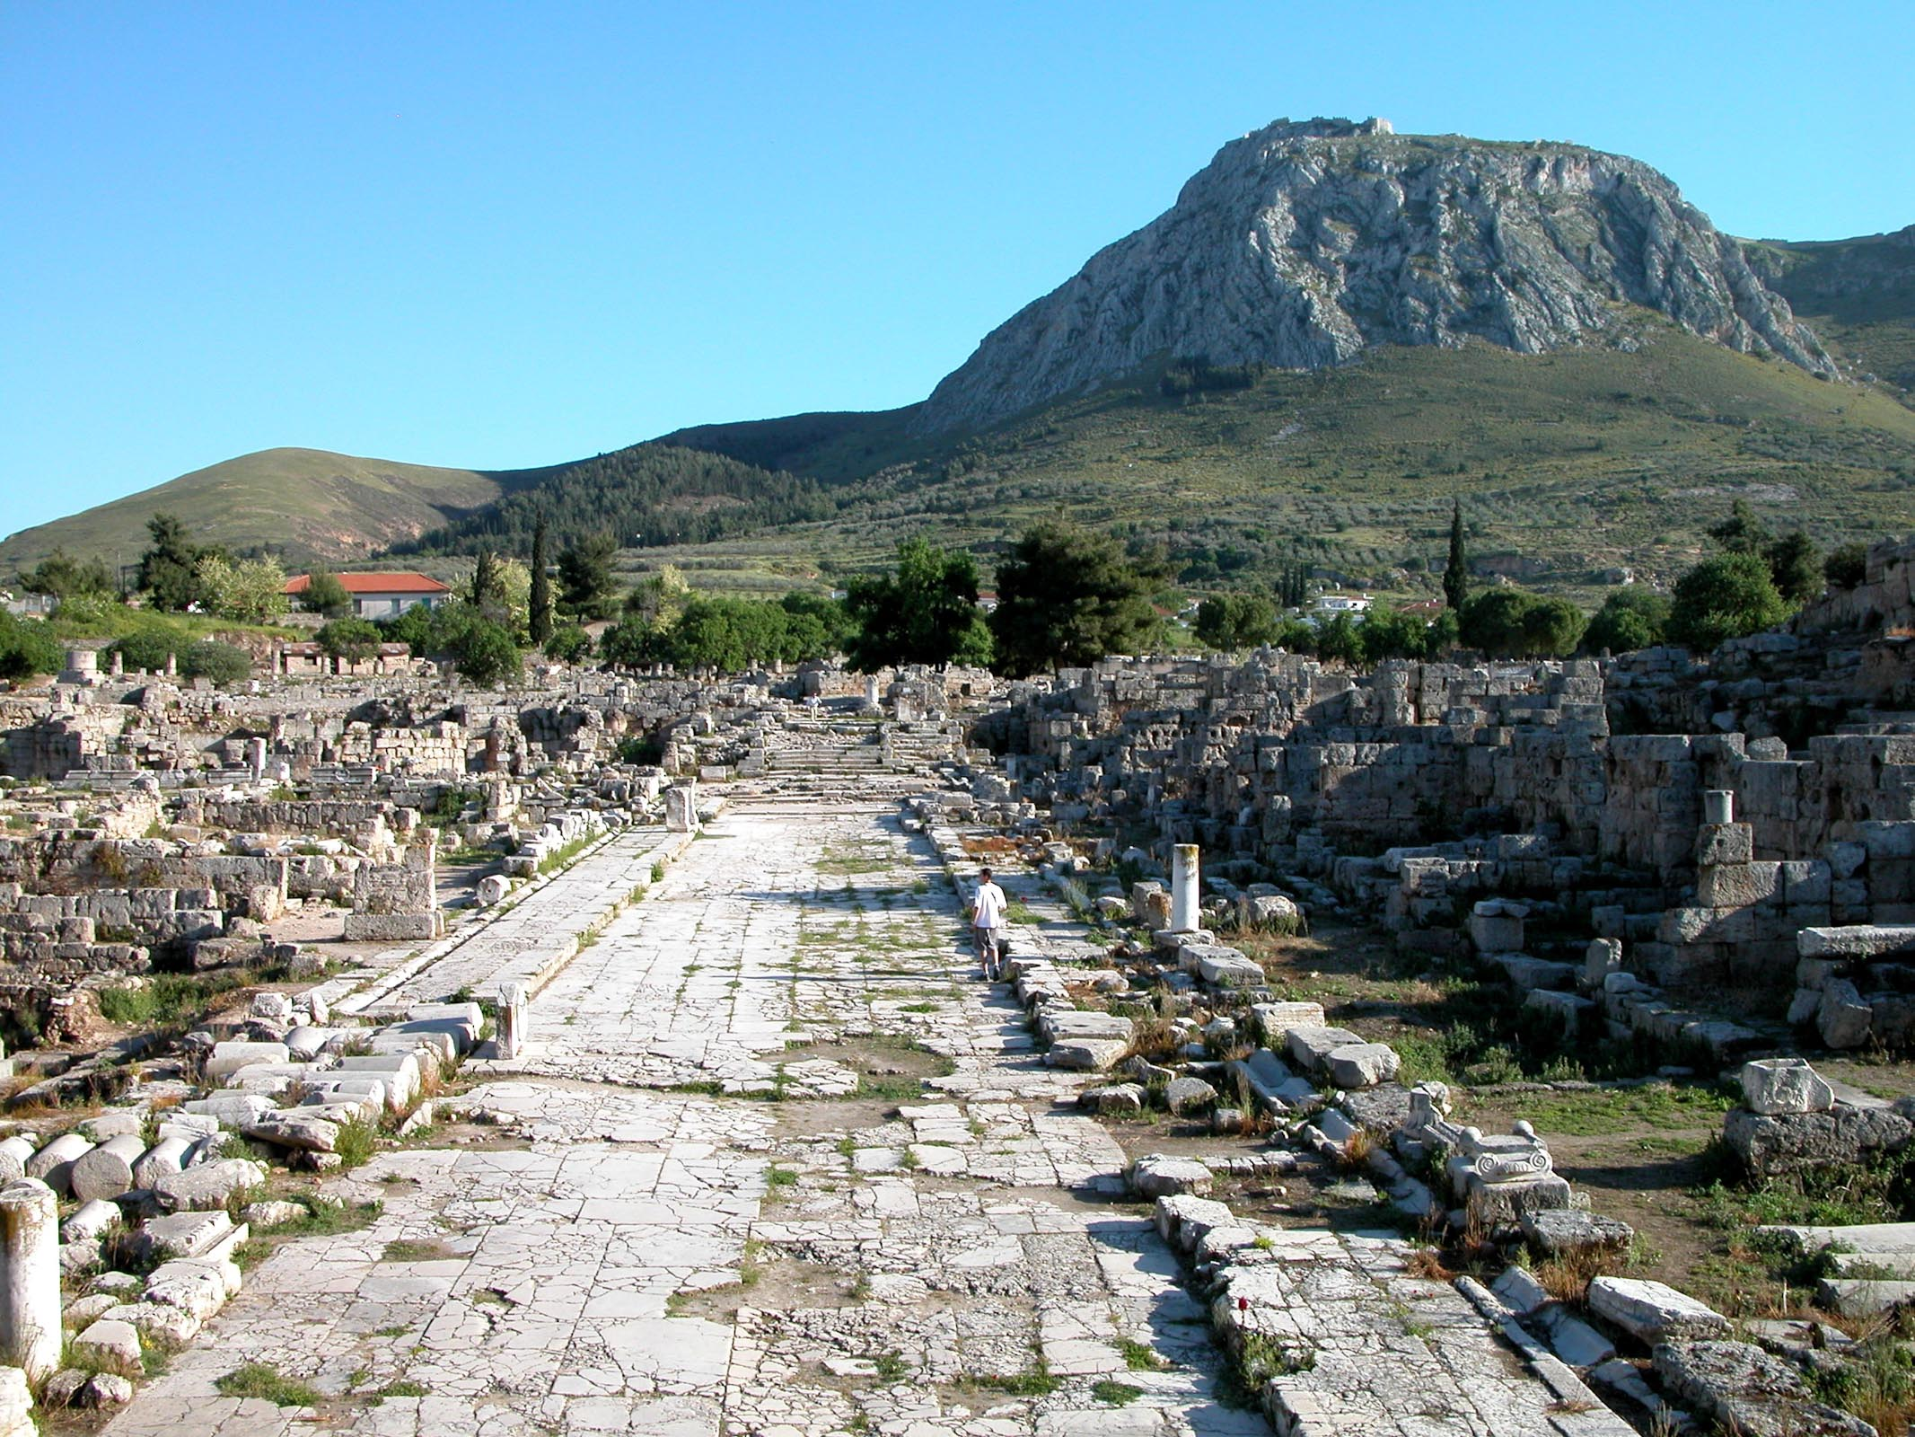
1 Corinthians 12.1 NET: “With regard to spiritual gifts, brothers and sisters, I do not
want you to be uninformed.”
Ruins of Ancient Corinth; Todd Bolen / BiblePlaces.com

Slide 2
What is a spiritual gift?
Spiritual gifts are ways that…
[1] God consistently works
[2] supernaturally in and through you,
[3] to bless others and build their faith.

Slide 3
What is their purpose?
1 Corinthians 12.7 NET: “To each person the manife-station of the Spirit is given for the benefit of all.”
1 Peter 4.10-11 NET: “Just as each one has received a gift, use it to serve one another as good stewards of the varied grace of God… so that in everything God will be glorified through Jesus Christ.”

Slide 4
What are the gifts?
1 Corinthians 12.8-10 NET: “For one person is given through the Spirit the message of wisdom, and another the message of knowledge according to the same Spirit, to another faith by the same Spirit, and to another gifts of healing by the one Spirit, to another performance of miracles, to another prophecy, and to another discernment of spirits, to another different kinds of tongues, and to another the interpretation of tongues.”

Slide 5
What are the gifts?
1 Corinthians 12.27-28 NET: “Now you are Christ's body, and each of you is a member of it. And God has placed in the church first apostles, second prophets, third teachers, then miracles, gifts of healing, helps, gifts of leadership, different kinds of tongues.”
1 Corinthians 14.26 NET: “When you come together, each one has a song, has a lesson, has a revelation, has a tongue, has an interpretation. Let all these things be done for the strengthening of the church.”

Slide 6
What are the gifts?
Romans 12.4-8 NET: “For just as in one body we have many members, and not all the members serve the same function, so we who are many are one body in Christ, and individually we are members who belong to one another. And we have different gifts according to the grace given to us. If the gift is prophecy, that individual must use it in proportion to his faith. If it is service, he must serve; if it is teaching, he must teach; if it is exhortation, he must exhort; if it is contributing, he must do so with sincerity; if it is leadership, he must do so with diligence; if it is showing mercy, he must do so with cheerfulness.”

Slide 7
What are the gifts?
Ephesians 4.11 NET: “It was he who gave some as apostles, some as prophets, some as evangelists, and some as pastors and teachers…”
1 Peter 4.10-11 NET: “Just as each one has received a gift, use it to serve one another as good stewards of the varied grace of God. Whoever speaks, let it be with God's words. Whoever serves, do so with the strength that God supplies, so that in everything God will be glorified through Jesus Christ. To him belong the glory and the power forever and ever. Amen.”

Slide 8
What are the gifts?
Speaking/revelation: apostle, wisdom, knowledge, prophecy, discernment of spirits, teaching, speaking, evangelism, exhortation/encouragement, tongues, interpretation of tongues
Serving: faith, helps, leadership, service, giving, mercy, shepherd/pastor, music, healing, miracles

Slide 9
What are the gifts?
Speaking/revelation: apostle, wisdom, knowledge, prophecy, discernment of spirits, teaching, speaking, evangelism, exhortation/encouragement, tongues, interpretation of tongues
Serving: faith, helps, leadership, service, giving, mercy, shepherd/pastor, music, healing, miracles, intercession/prayer? hospitality? crafts?

Slide 10
What are the gifts?
Tongues
 New Testament examples when everyone spoke in tongues were special events to prove God was extending the New Covenant to all people groups.
 The gift of tongues was not for all believers.
 The Spirit-led public use of tongues was accompanied by Spirit-led interpretation by another.

Slide 11
What are the gifts?
Prophecy
 Old Testament prophecy mostly was calling people back to the covenant with God.
 If God were to use believers today prophetically, it would be to call us back to our covenant with him, obedience to his commands and faith in his promises.
 Nobody will hear something universal today.
 Anyone predicting in God’s name better be correct! The biblical standard is death for those in error.

Slide 12
Have some disappeared?
View 1: God has stopped using 45% of the listed gifts.
 only needed in early church / pre-Bible period
 charismatic believers are not glorifying God
new revelation would challenge the sufficiency or canonicity of scripture
View 2: God uses all gifts as he sees fit.
still needed today
true use of any gift would glorify God
new revelation does not challenge doctrines about scripture; and we already believe the Spirit works these ways directly in us

Slide 13
Have some disappeared?
View 1: God has stopped using 45% of the listed gifts.
View 2: God uses all gifts as he sees fit.
1 Corinthians 1.7 NET: “…you do not lack any spiritual gift as you wait for the revelation [the return] of our Lord Jesus Christ.”
1 Corinthians 13.8-10 NET: “Love never ends. But if there are prophecies, they will be set aside; if there are tongues, they will cease; if there is knowledge, it will be set aside. For we know in part, and we prophesy in part, but when what is perfect comes, the partial will be set aside.”

Slide 14
Who receives gifts?
1 Corinthians 12.4-7 NET: “Now there are different gifts, but the same Spirit. And there are different ministries, but the same Lord. And there are different results, but the same God who produces all of them in everyone. To each person the manifestation of the Spirit is given for the benefit of all.”
1 Corinthians 12.29-30 NET: “Not all are apostles, are they? Not all are prophets, are they? Not all are teachers, are they? Not all perform miracles, do they? Not all have gifts of healing, do they? Not all speak in tongues, do they? Not all interpret, do they?”

Slide 15
How do we get gifts?
Ephesians 4.11 NIV: “So Christ himself gave the apostles, the prophets, the evangelists, the pastors and teachers…”
1 Corinthians 12.8-11 NET: “For one person is given through the Spirit the message of wisdom, and another the message of knowledge according to the same Spirit, to another faith by the same Spirit, and to another gifts of healing by the one Spirit… It is one and the same Spirit, distributing as he decides to each person, who produces all these things.”

Slide 16
How do know our gifts?
How is God working through you?
How has God “SHAPEd” you for ministry?

Slide 17
What is our responsibility?
1 Peter 4.10 NET: “Just as each one has received a gift, use it to serve one another as good stewards of the varied grace of God.”

Slide 18
What is our responsibility?
1 Peter 4.10 NET: “Just as each one has received a gift, use it to serve one another as good stewards of the varied grace of God.”
1 Corinthians 9.16 NET: “For if I preach the gospel, I have no reason for boasting, because I am compelled to do this. Woe to me if I do not preach the gospel!”

Slide 19
What is our responsibility?
1 Corinthians 12.20-25 NET: “So now there are many members, but one body. The eye cannot say to the hand, ‘I do not need you,’ nor in turn can the head say to the foot, ‘I do not need you.’ On the contrary, those members that seem to be weaker are essential, and those members we consider less honorable we clothe with greater honor, and our unpresentable members are clothed with dignity, but our presentable members do not need this. Instead, God has blended together the body, giving greater honor to the lesser member, so that there may be no division in the body, but the members may have mutual concern for one another.”

Slide 20
What is our responsibility?
1 Corinthians 13.1-3 NET: “If I speak in the tongues of men and of angels, but I do not have love, I am a noisy gong or a clanging cymbal. And if I have prophecy, and know all mysteries and all knowledge, and if I have all faith so that I can remove mountains, but do not have love, I am nothing. If I give away everything I own, and if I give over my body in order to boast, but do not have love, I receive no benefit.”

Slide 21
What is our responsibility?
Matthew 28.19-20 NET: “Therefore go and make disciples of all nations, baptizing them in the name of the Father and the Son and the Holy Spirit, teaching them to obey everything I have commanded you.”
 Let God use your unique design in his mission for evangelism, teaching, and mentoring.

Slide 22
What is our responsibility?
Matthew 28.19-20 NET: “Therefore go and make disciples of all nations, baptizing them in the name of the Father and the Son and the Holy Spirit, teaching them to obey everything I have commanded you.”
 Let God use your unique design in his mission for evangelism, teaching, and mentoring.
 Find ways God could use your gifts in the ministries of the church.
 No matter what your gifts, be obedient to all commands of scripture.

Slide 23
1 Corinthians 12.1 NET: “With regard to spiritual gifts, brothers and sisters, I do not
want you to be uninformed.”
Ruins of Ancient Corinth; Todd Bolen / BiblePlaces.com

